Slide 1
Predicting VG hits
Using Machine Learning Algorithms

Slide 2
My Details
Name:N.Suvarna
ID no.:s180820
Class:CSE-2C
Github account:suvarnananabala

Slide 3
Predicting VG hits with Logistic Regression
Sales>=1Million
TRUE
FALSE
Hit
Not Hit

Slide 4
Logistic Regression
Logistic Regression is used when the dependent variable(target) is categorical.
Logistic regression is useful when the response variable is binary but the explanatory variabes are continuous.

Slide 5
How this prediction helps
For sellers
Can we recruit more staff
For Users
To buy it or not
Selling it for more profit

Slide 6

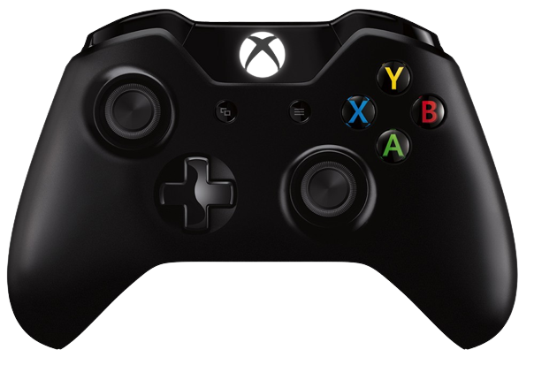


Input values
Platform
Genre
Publisher
Critic score

Slide 7
Output values
HIT
NOT HIT

Slide 8
Libraries used
Pandas
matplotlib.pyplot
Seaborn
from sklearn.model_selection import train_test_split
from sklearn.ensemble import RandomForestClassifier
from sklearn.linear_model import LogisticRegression
from sklearn.metrics import classification_report
from pandas import get_dummies
import re

Slide 9
Predicted outcome
Testing data set
Training Data set
Prediction models
Data
Pre-processor
Data

Slide 10
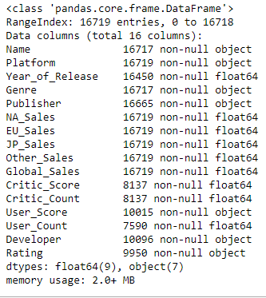
DATA

Slide 11
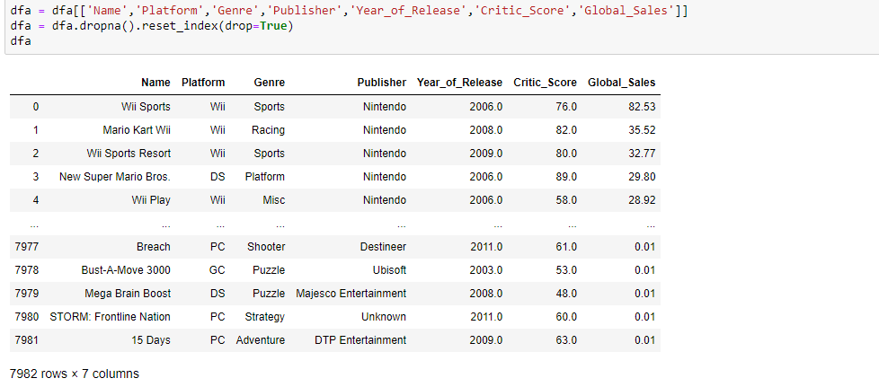
Data Pre-processing
Preparing the raw data and making it suitable for a machine learning model.

Slide 12
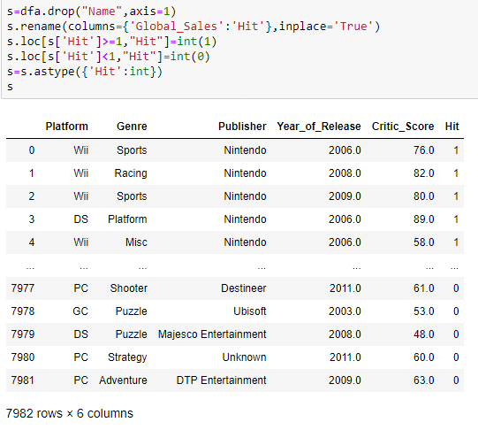
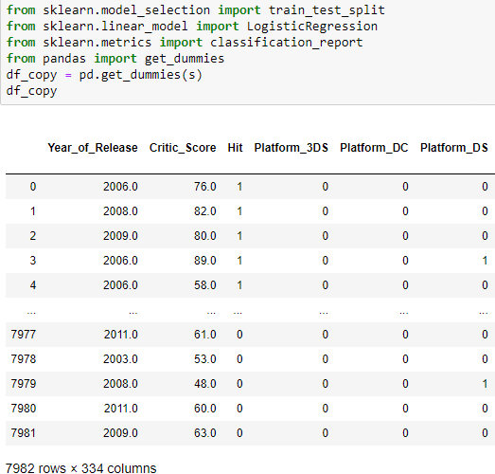
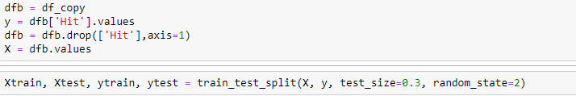

Slide 13
Prediction model
I have used logistic regression, as my dependent variable is binary
I have used random forest tree also, but logistic regression gives more accuracy than random forest

Slide 14
Training data set
I have trained my model using below line
model = LogisticRegression().fit(Xtrain, ytrain)

Slide 15
Testing data set
I have test my model using below line
y_pred=model.predict(Xtest)

Slide 16
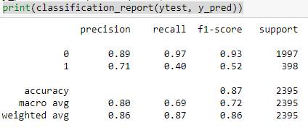
Predicted outcome
It gives predicted values of dataset after applying logistic regression
Acuuracy: 0.87

Slide 17
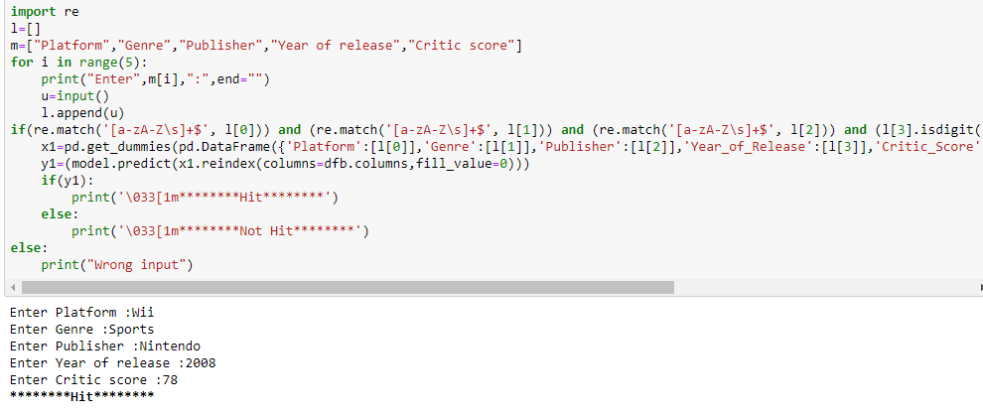

Slide 18
Conclusion
Predicting video game hit can help to sellers to make decisions precisely
Using this prediction model we can predict ,video game will hit or not hit with 0.87 accuracy

